Slide 1
Dr. Ambedkar Institute Of Technology For Handicapped
Kanpur
ORGAN DONORS PREDICTION

Slide 2
MEMBERS
Brij Kishor 1901660100022
Saman Khan 1901660100052
Dinisha Jaiswal 1901660100024

Slide 3
Topic Overview & Problem Statement
The basic idea of this topic is to predict the organ donors based on the data that we have in the dataset of the kaggle.
The motivation for this project is clearly related to health situation in the present world. Since we can see that in the current situation of the world, its kind of very difficult to find the correct match for the organ donation and in case of emergency it really become a hectic to get a correct organ donor and initiate the process of organ replacement.
So here keeping in mind the above problem, we basically developed a machine learning model to predict the donors from the datas present in the our datasets.

Slide 4
Dataset
Dataset that we used to train and test our machine learning is we took one from the Kaggle site. Below is the link for reference.
https://www.kaggle.com/datasets/momohmustapha/donorsprediction
The datas present in the dataset are about basic details of each donors like, donors Age, donors is from urban or rural areas, his/her gender, etc. Using this data, we built a Machine learning model and trained and tested with different algorithms and compared the accuracy among each.
Data is present in .csv file, and we load that data into our model by reading it using pandas library present in python.

Slide 5
Implementation
In the implementation part, first we got the data set from Kaggle site. After that, we made our machine learning model in Jupyter Notebook.
We preferred Jupyter Notebook, because its helps in running and compiling python codes in cluster, like we can run codes in clusters in Jupyter Notebook cells.
First we splitted our implementation part in two directory, first one is Dataset and second one is Model part. In Dataset part we stored the dataset in .csv format and in the model part we proceeded with the implementation part of our code.
In the implementation part, we proceeded our model creation part with the following 6 steps, that we stated in the next workflow section.

Slide 6
Workflow
We have designed workflow for the implementation part. It includes all the basic steps that a machine learning model should have.
We followed workflow for our model creation.
Step 1:Data Exploration
Step 2: Data Preparation
Step 3: Data Visualization
Step 4:Data training
Step 5: Model Creation
Step 6: Performance Evaluation

Slide 7
Tools & Technologies Used
Python Language
Jupyter Notebook
Machine Learning
Python’s Sklearn, pandas, numpy, matplotlib
Some other useful python libraries

Slide 8
Workflow Implementation
Step 1: Data Exploration
In this very first step, we first read the data from .csv file and using pandas library.
Then got the shape and size of our dataset, like no of rows and attributes present in it.
Step 2: Data Preparation
In this step, After analysing the data, we cleaned the data here. We dropped the attributes(columns) from the dataset that has the Nan or Null or empty. Also we replaced some of the special character present in dataset to some meaningful characters.
By doing this we effectively got the correct updated dataset which is kind of ready for get training.

Slide 9
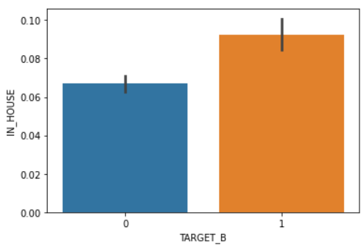
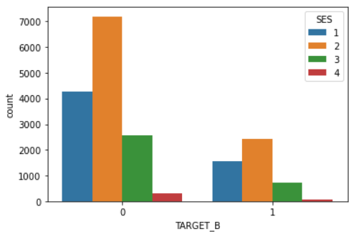
Step 3: Data Visualization
Here we visualized the dataset that we cleaned in the step 2 , using the different python visualization library like seaborn, matplotlib, etc.
And we analysed the data using the following representation of graph, that we call heatmap.

Slide 10
Step 4: Data Training
After data visualization step, we trained the data.
Before this first we splitted the dataset into two proportion, such that we trained the first 80% data and we tested the remaning 20% data.
And we did the above thing using the sklearn.modelselection library present in python.
Step 5: Model Creation
In this part, since we have splitted the training and testing dataset, here will be fitting the training dataset into different machine learning algorithm and predict the output for the remaining 20% dataset that we have for testing. And along with the we tested the accuracy of each model using the score function present in the sklearn library.

Slide 11
For model training and testing, we in total used the 8 machine learning model, trained and tested with each of them and got the accuracy for each and compared them.
Below are the ML algorithms that we used:
Logistic Regression
Linear Regression
Ridge Regression
K Neighbours Classifier
Lasso Regression
Random Forest Classifier
Decision Tree Classifier
XG Boost Classifier
For each of the above ML algorithm first we fit the 80% data for training and then we tested the rest 20% data and got the accuracy of its prediction.

Slide 12
We followed the following steps in each of the above 8 algorithm to get the accuracy for that particular algorithm of prediction.
Step 1: First using the sklearn library we import that model into out code.
Step 2: Then we fit the training part of the dataset into the imported model using the fit function present.
Step 3: After fitting we predict the output for the 20% testing data.
Step 4: At the final step, we get the accuracy of that model using the score function present in that library. That accuracy basically shows how well the model trained and tested the data according to its predefined algorithm.

Slide 13
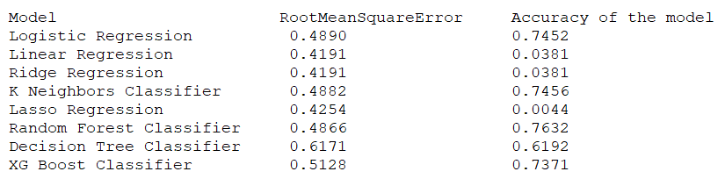
Result
After training the dataset and testing, we got the following results, representing the accuracy score and root mean square value for each of the algorithm.
Conclusion:
Accuracy of Regression models- Linear regression, rigde regression, Lasso Regression is very low. Whereas accuracy of Logistic Regression, K Neighbors Classifier, Random Forest Classifier, XGBoost Classifier, and Decision Tree Classifier is almost same. And the Accuracy of the Random Forest is more, so it is efficient among all.

Slide 14
Conclusion and Future Scope
With the use of the Model, A medical organization can automate the health related queries without any hassle and process a large number of queries at once related to getting the correct match for the organ donors for the particular patients based on its data.
Assistants of Doctors can use the model to serve the patients of different organ needs.
Even a naïve person can use it for their own purpose after being consulted by a certified medical practitioner.
Conclusively, implementing this model in real life will be of great help.

Slide 15
References
[1] Gotlieb, Neta, et al. "The promise of machine learning applications in solid organ transplantation." NPJ digital medicine 5.1 (2022): 1-13.
[2] Briceño, Javier, María Dolores Ayllón, and Rubén Ciria. "Machine-learning algorithms for predicting results in liver transplantation: the problem of donor–recipient matching." Current Opinion in Organ Transplantation 25.4 (2020): 406-411.
[3] Data set – Kaggle (https://www.kaggle.com/datasets/momohmustapha/donorsprediction)
[4] Marrero, W.J., Lavieri, M.S., Guikema, S.D., Hutton, D.W. and Parikh, N.D., 2021. A machine learning approach for the prediction of overall deceased donor organ yield. Surgery, 170(5), pp.1561-1567.

Slide 16


